Slide 1
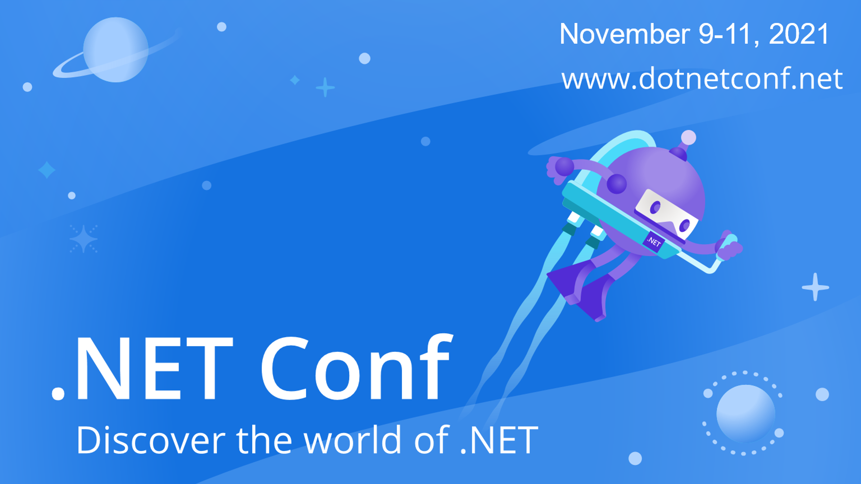

Slide 2


Stories from interning on the .NET team
Cathy Sullivan | @cathysull
Jessie Houghton
Sophia Carpenter

Slide 3


Meet Jessie and Sophia
Jessie Houghton
University of Michigan
Computer Science, Minor in Art and Design
Sophia Carpenter
University of Washington
<Add major here>
Notes:
Who you are, where you’re from, your school, what you’re studying…
Show us your project
Project details, how you figured out what to do…
What did you learn? Talk about growth mindset, etc.
Want to intern at Microsoft?
Q&A

Slide 4
Model Explainability and Responsible AI in ML.NET
Jessie Houghton

Slide 5
Task: Drive the direction
of Model Explainability and Responsible AI in ML.NET
Project goals
Ramp up on
the basics of Machine Learning and ML.NET
the target customers and goals of ML.NET
model explainability and why it’s important
competitors in the space
Conduct customer development to identify and understand pain points around model explainability in ML.NET
Collaborate with engineering, UX, and designers to come up with solutions to validated problem hypotheses, and test these concept / feature hypotheses via product development
Analyze and present findings to leadership
Spec functional requirements for a new feature
Project outcomes
A spec which recommends the direction we should take in terms of Model Explainability in ML.NET
A deck / presentation to present findings and recommendations to leadership

Slide 6
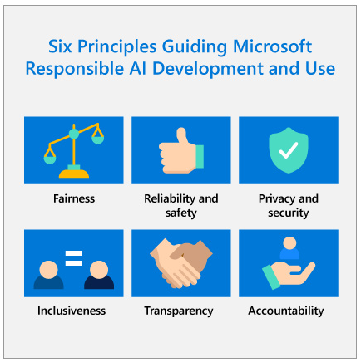
Why Model Explainability in ML.NET?
Model Explainability helps to answer why the model made certain predictions based on the data you used to train it
We need explainability for
Model debugging - Why did my model make this mistake?
Feature Engineering - How can I improve my model?
Detecting fairness issues - Does my model discriminate?
Human-AI cooperation - How can I understand and trust the model's decisions?
Regulatory compliance - Does my model satisfy legal requirements?
High-risk applications - Healthcare, finance, judicial, ...
Connecting deeply to Fairness we seek to deliver similar quality of service, equitable allocation of resources and opportunities, and accurate representation across groups.

Slide 7
Within ML.NET we already offer:
Model Feature Importance – model specific
Feature Contribution Calculator (FCC) – local analysis
Permutation Feature Importance (PFI) – global analysis**
One tutorial for PFI exists and there are a few samples in the sample repository for explainability, but they’re not linked together, and many ML.NET customers have not heard of any of them. Of these, our users found PFI difficult to use specifically with AutoML and handling the return type according to active GitHub issues.

Slide 8
Key Insights – User Study (8 participants)
New ML users don’t know how to integrate explainability into their workflows
They’d like to see it integrated into the existing pipeline
Experienced users want to see more advanced explainability features
None of the participants could complete the task of using the Permutation Feature Importance API with AutoML

Slide 9
Key Insights – Survey (300+ respondents)
Only 9% of respondents stated they were already working on fairness
~50% had never used or heard of the explainability features in ML.NET, despite using ML.NET
Customers would like to see more documentation, samples, and tutorials for the existing explainability features
Top feature requests:
Decision Tree Visualizations
Training Pipeline Visualizations
Partial Dependence Plots

Slide 10
Key Insights – User Study Part 2 (7 participants)
Customers were wholly more successful with the updated PFI API than the original PFI API tested in the last user study.
Customers were excited about the mockups for expanded explainability offerings, saying it made explainability part of their workflow, would help them learn and share insights with customers, but they had varied ideas of how the information should be presented. They also thought autogenerated graphs gave them the value without having to write the code and create graphs on their own.
Customers have mixed feelings about fairness where many don’t see how fairness relates to their use case. Most believe fairness is the responsibility of the user, but the tooling can help

Slide 11
Next Steps
Task | Customer Priority | Impact/ Effort
Deploy the suggested PFI API updates (Link to spec).
Merge the proposed changes to the PFI API into the main branch. | P0 | High impact, low effort
Update the existing tutorial and documentation for PFI. | P0 | Mid impact, low effort
Iterate on designs for incorporating explainability into Model Builder.
Add a generated graphic for PFI into Model Builder. | P0 | High impact, mid effort
Investigate how to surface more interactive explainability features in Model Builder on an Explain page, both design and engineering. | P1 | High impact, high effort
Add a prompt like “How do I explain my model?”. | P1 | High impact, low effort
Investigate relationship between .NET Interactive and explainability in Model Builder and Visual Studio. | P0 | High impact, mid effort
Continue customer and technical research on robust tools for evaluating fairness in C# | P1 | High impact, mid effort
Make updates to the ML.NET dotnet homepage or documentation to highlight explainability as a priority. | P0 | Mid impact, low effort

Slide 12
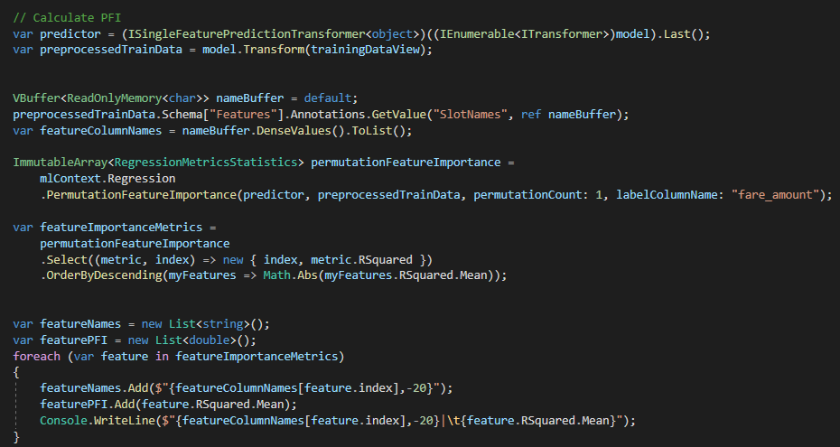
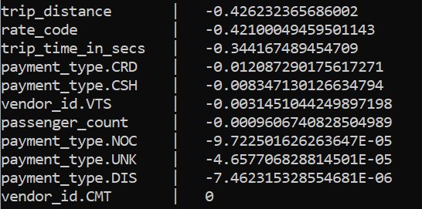
Old PFI with Taxi Fare
8 Lines

Slide 13
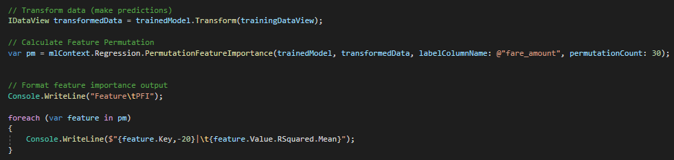
New PFI with Taxi Fare
1 Line

Slide 14
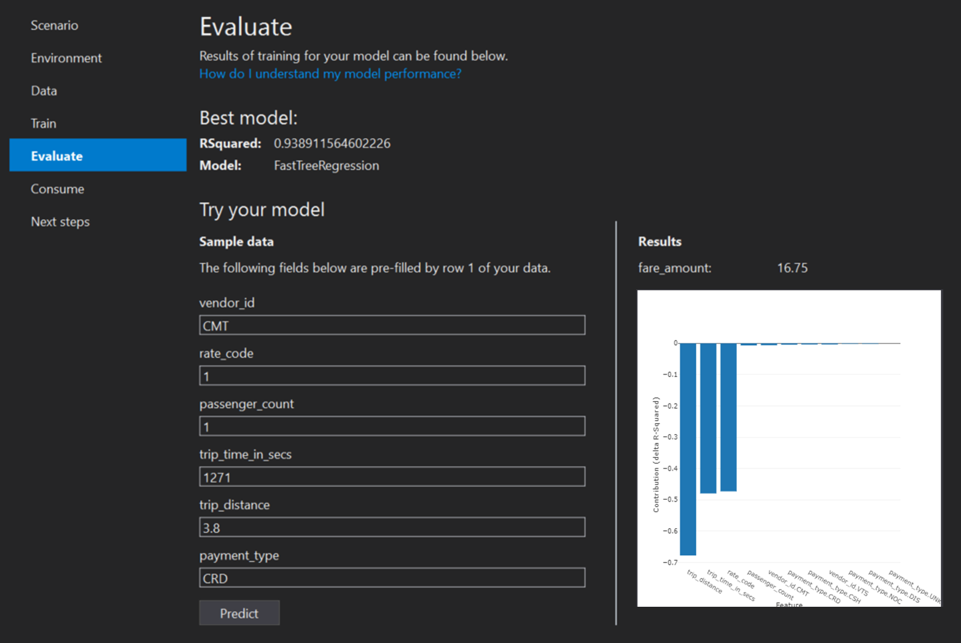
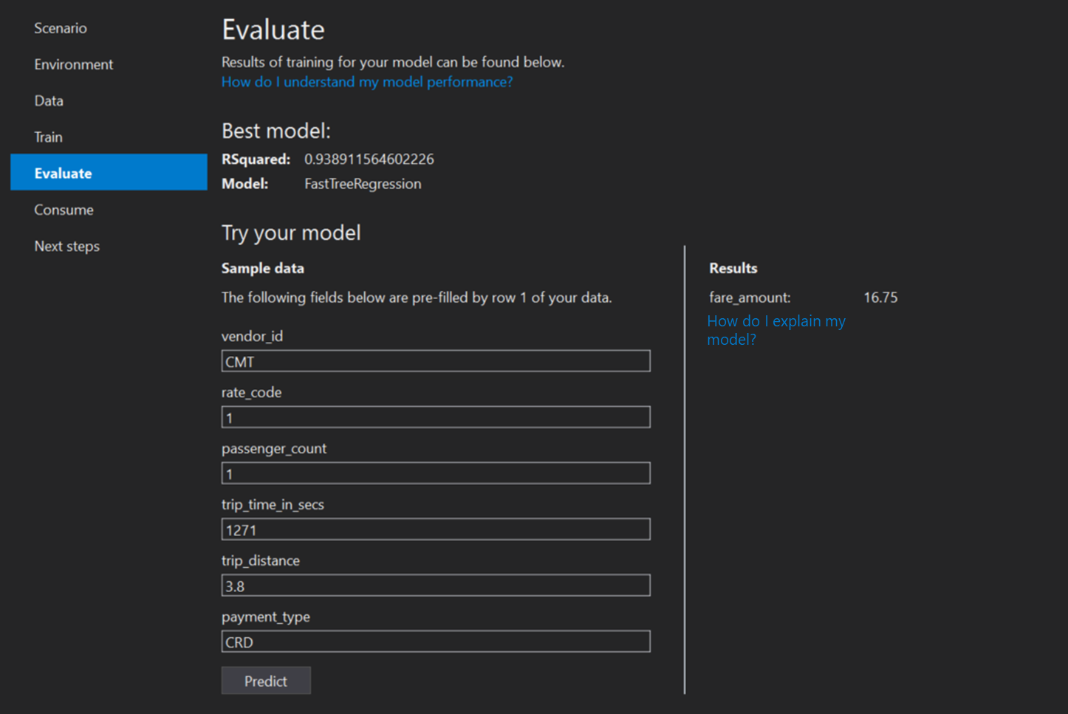
Mockups – Evaluate Page

Slide 15
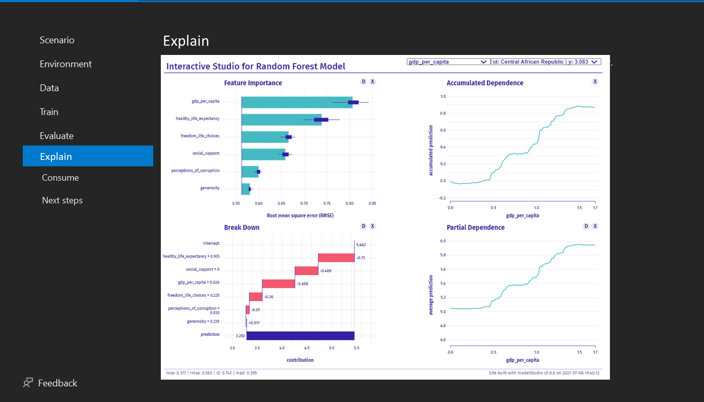
Mockups – Explain Page

Slide 16
This Summer, I learned how to
Leverage the Hypothesis Progression Framework
Balance trying something new on my own with asking for help
Find expertise both inside and outside my team
Communicate my vision to a variety of audiences
Grow my network with other interns and FTEs over shared passions and interests
Look for more ways to contribute to the broader mission of the team

Slide 17

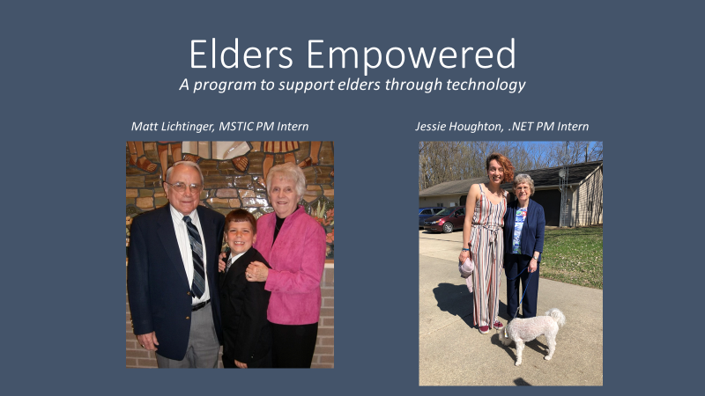

Other things I got up to this summer at Microsoft
Collaborated with other interns on a book club program to bring interns from different backgrounds together to share diverse perspectives
We read Sapiens and
Brave New World
Pitched a program to support elders through technology with another intern for the MS Invent competition
Completed training courses to obtain the Accessibility in Action badge, and other training course on Diversity and Inclusion

Slide 18
.NET Learn Portal Redesign & C# 101 Interactive Notebooks
Sophia Carpenter

Slide 19
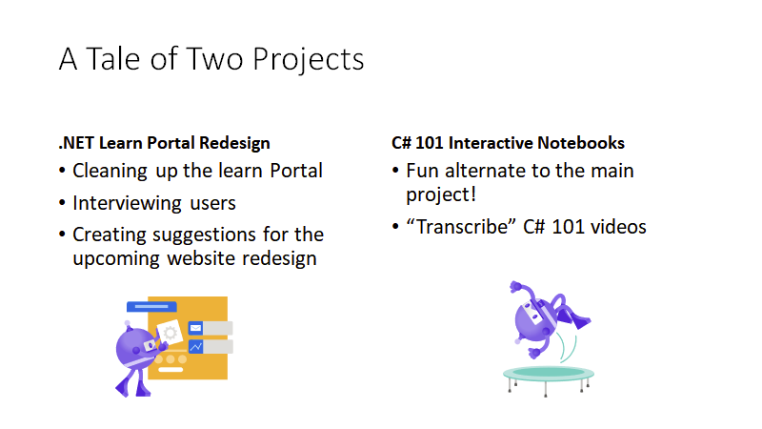

Slide 20
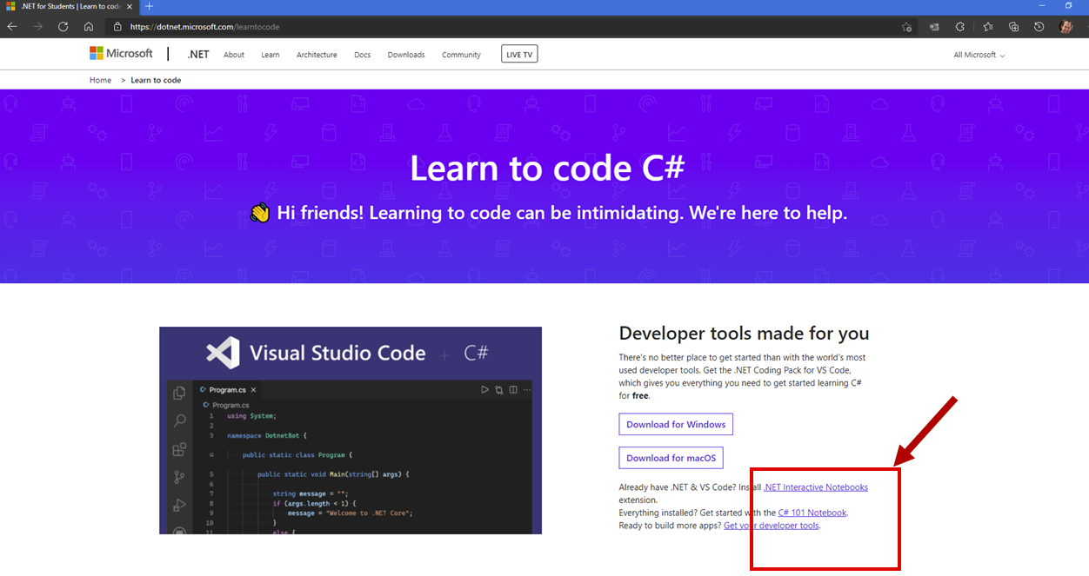

Slide 21
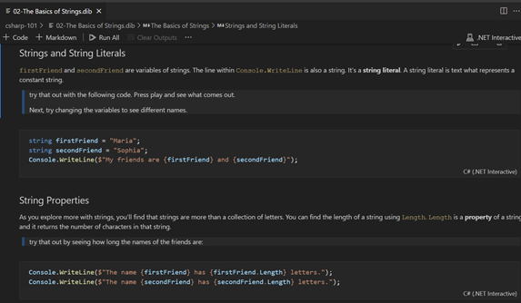
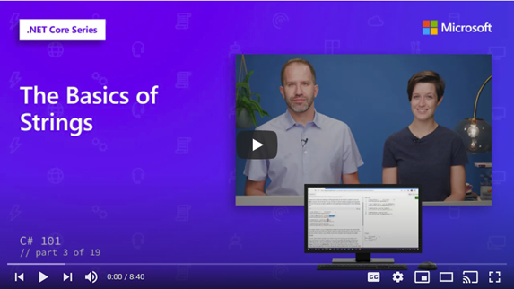
A "Side Project"
Notes:
-side project” , = down time. BUT half my work
-Based on Visual Studio Interactive Notebooks
-Great for schools and Education
-My work
-Take C# 101 videos by Scott and Kendra
-Transcribe into 15 notebooks
-Goes from very beginning to introducing object-oriented programing

Slide 22
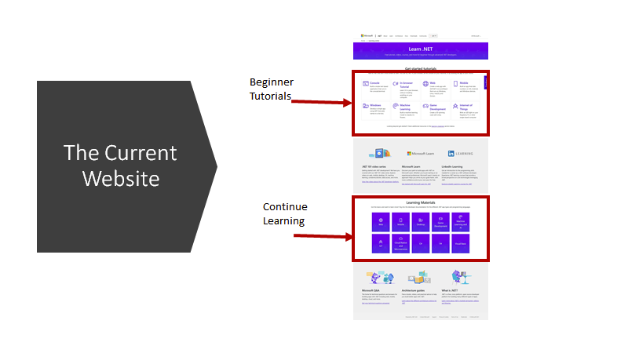
Notes:
There are 2 chunks I want to talk about
1st: Beginner modules
2nd: Continue learning modules

Slide 23
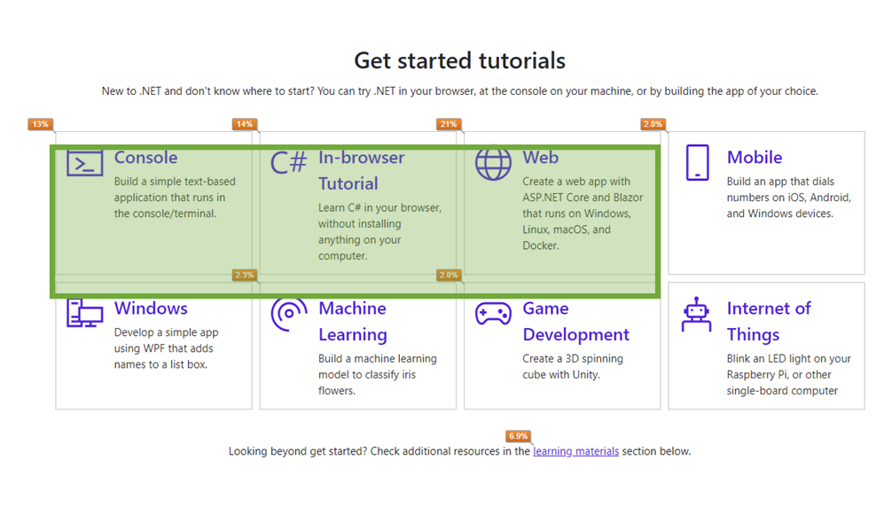
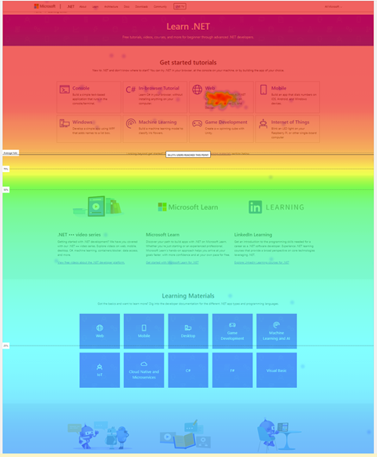
Focus and Scrolling
Notes:
There’s really only three boxes that are used in the get started tutorial.
Unfortunately, folks don’t see the learning.
These percentage of use is maximum 4%. Users don’t seems to scroll.

Slide 24
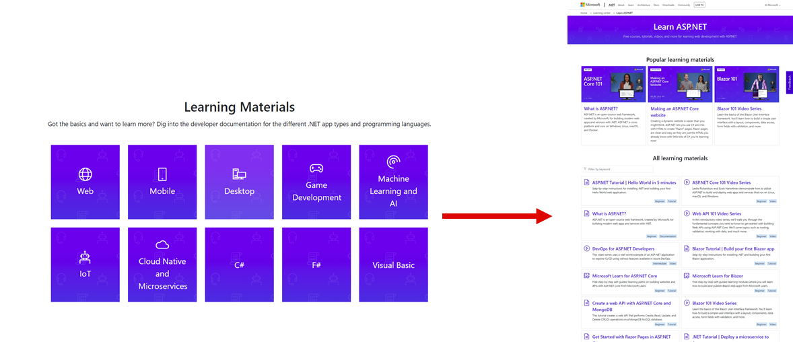
Secondary Pages Bounce Rate
Notes:
•C#: 80%
•Web: 70%
•Mobile (Xamarin): 67%
•Games: 50%
•Microservices: 50%

Slide 25
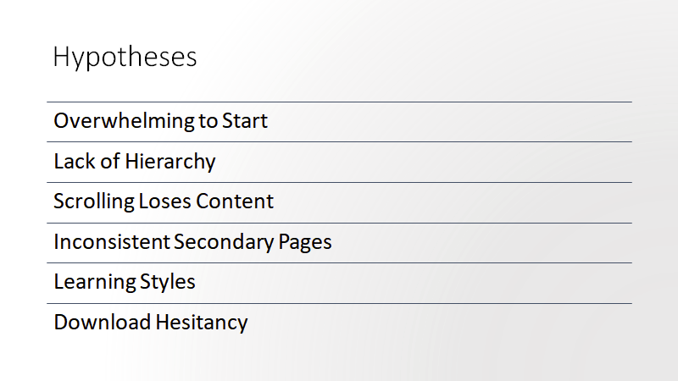
Notes:
1.
-new .NET developers
-overwhelmed with the number of options to get started
2.
-new .NET users get
-overwhelmed by the website
-lack of hierarchy
3.
-developers
-looking for materials beyond get started
- don't find the additional resources
-because scroll to the bottom
4.
-new .NET developers
-get confused because they get
-sent to inconsistent locations when selecting learnings.
5.
-.NET users seeking to learn new material
-have specific learning styles they prefer,
-And get frustrated with the current site because they
-can't filter or search for their learning style.
6.
-new to .NET learners
-drop off when a learning needs them to download content,
-don't want to commit to downloading anything yet.

Slide 26
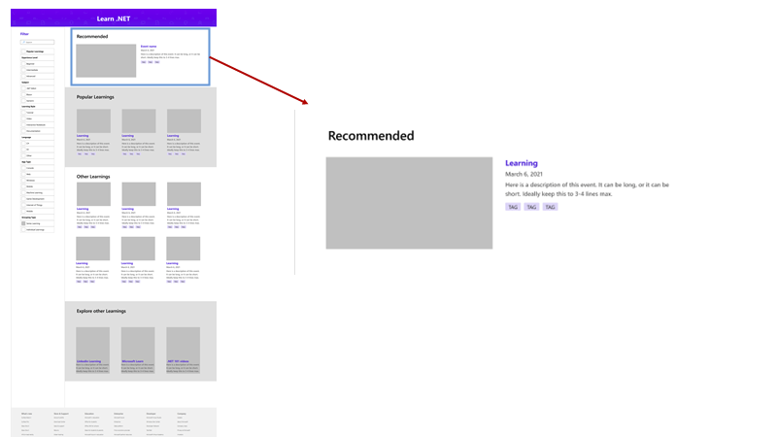

Slide 27
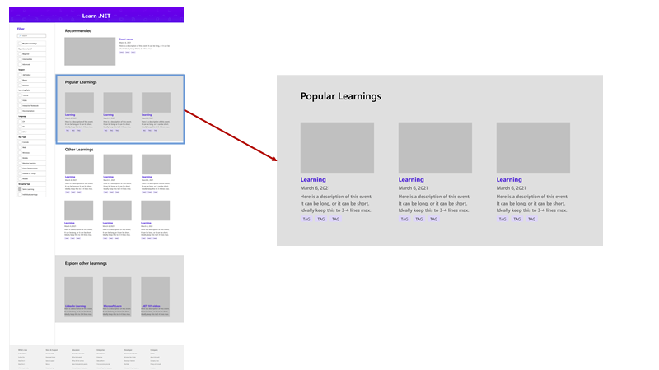

Slide 28
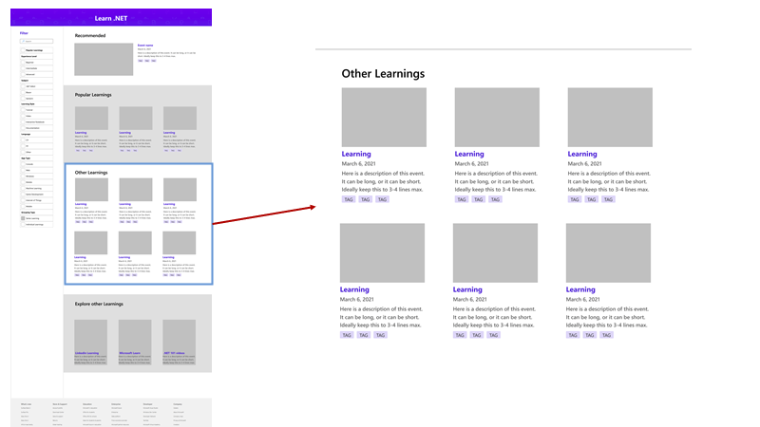

Slide 29
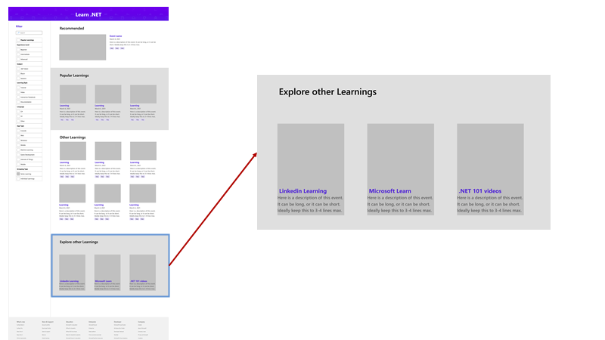

Slide 30
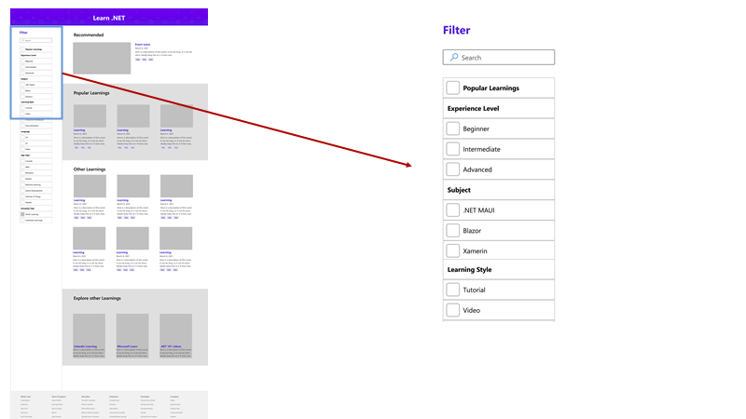

Slide 31
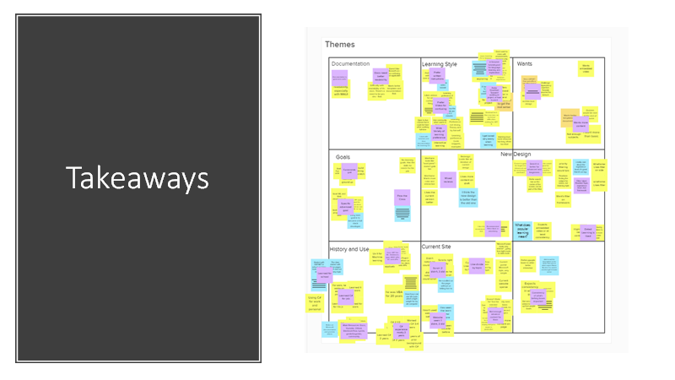

Slide 32
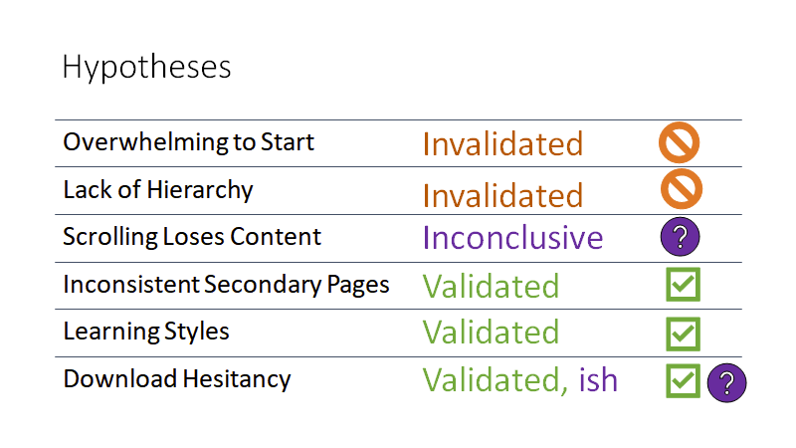

Slide 33
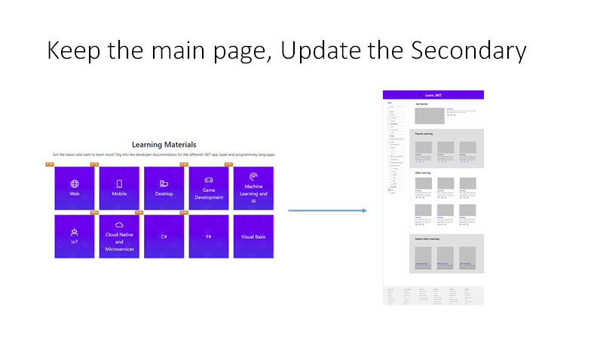

Slide 34
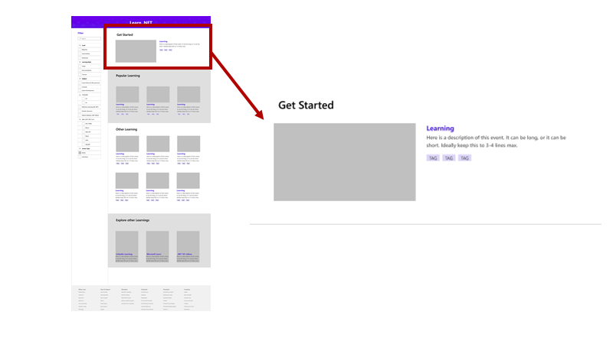

Slide 35
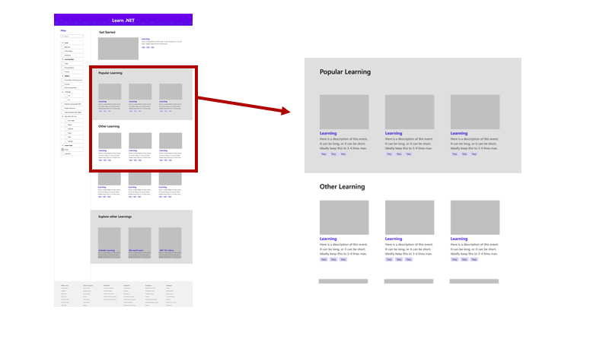

Slide 36
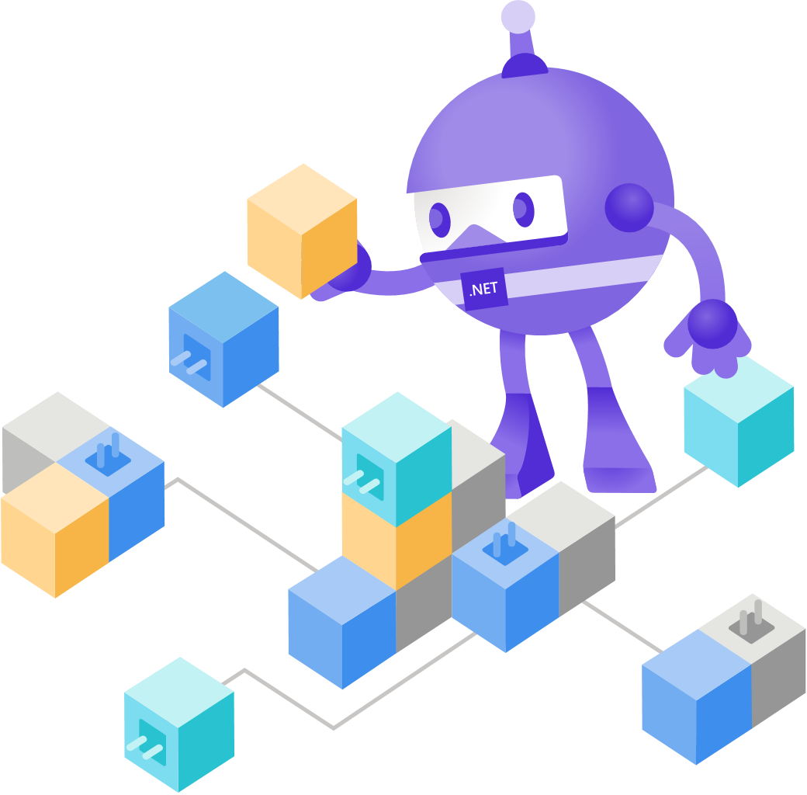
Looking Back
Met so many cool humans!
Tried out a bunch of stuff
Built useful material
Art group exchange!

Slide 37
Want to intern at Microsoft?
Learn about all the different internships at Microsoft:
https://microsoft.com/university

Slide 38
How to apply
Apply online
Resume Review
1st Round Interviews
Final Round Interviews
Offers!
microsoft.com/ university
Recruiter reviews your resume
First interview scheduled
Final round interview scheduled
Offer Decision
30 min phone interview
Blend of technical + behavioral questions
2-4 virtual interviews with the team that you are being considered for
Candidates typically have 2 weeks to decide on their offer!

Slide 39
Q&A

Slide 40
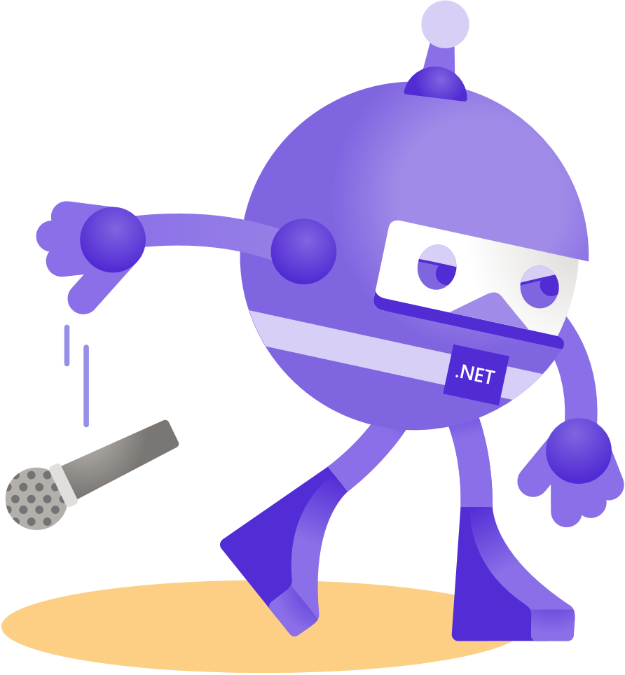
Thanks for joining!

